Slide 1
《蓉城主阵地》2024-2025学年英语
七年级上册
Starter Unit 1

Slide 2
STARTER UNIT 1
SECTION B
2a-2b
读写课

Slide 3
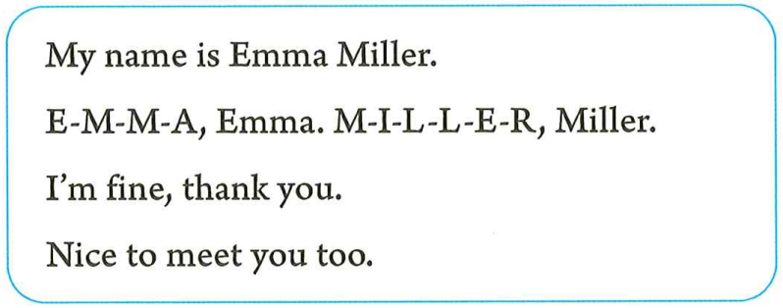
/ə/
/e/
/ɪ/
/ɑː/
再读一遍1b的对话。用方框中正确的回复填空。
how to do it quickly?
Find the key words.
expressions
Can you add more?
Are they all in one conversation?
I’m fine, thank you.
And you?
My name is Emma Miller.
Nice to meet you too.
E-M-M-A, Emma. M-I-L-L-E-R, Miller.
You can call me Emma.

Slide 4
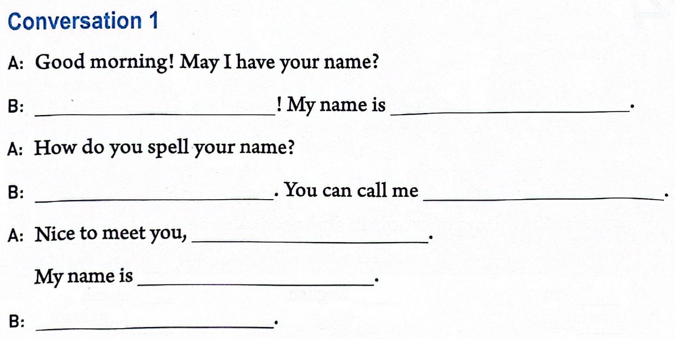
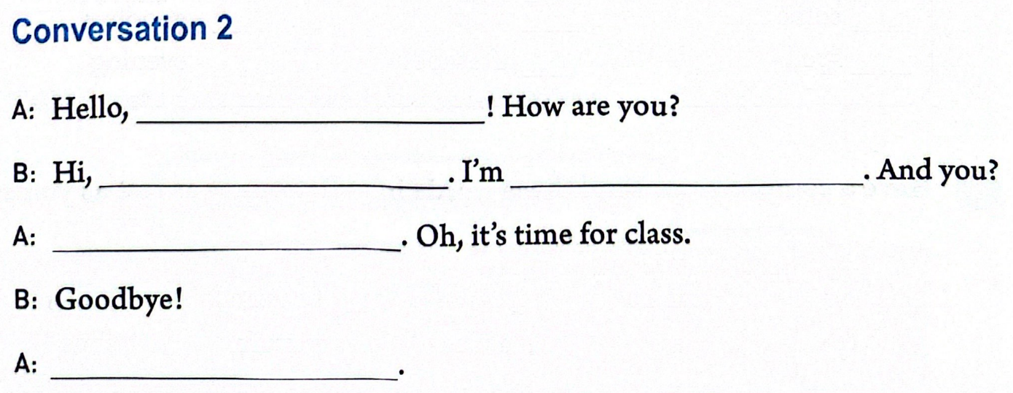
Evaluation:
1.Pronunciation.
2.Intonation.
3.Fluency.
4.Facial expression.
5.Body language.
完成对话。然后与同伴角色扮演。
meet for the first time
full name！
Emma Miller？
know each other
Evaluation:
1.Sentence pattern.
2.Spelling.
It’s time to go to class.
That’s the bell.
Let’s go to class.

Slide 5
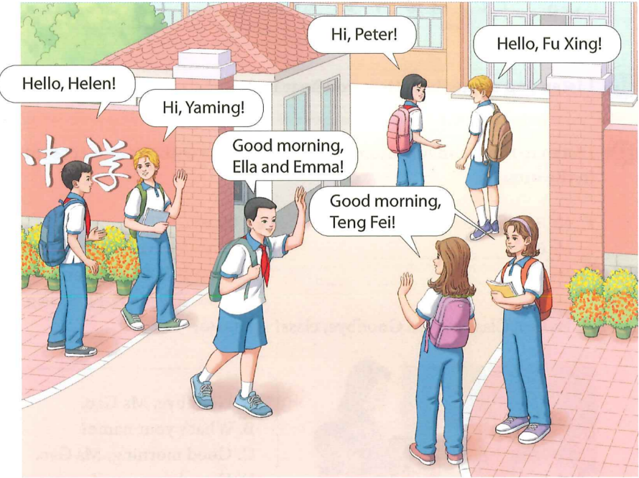
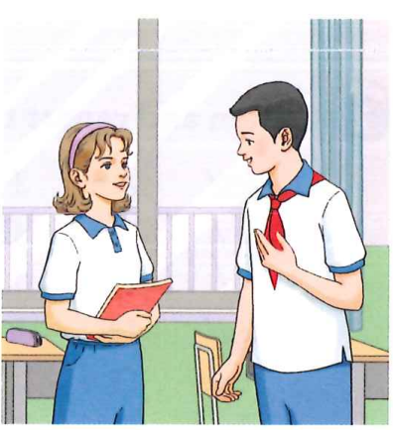
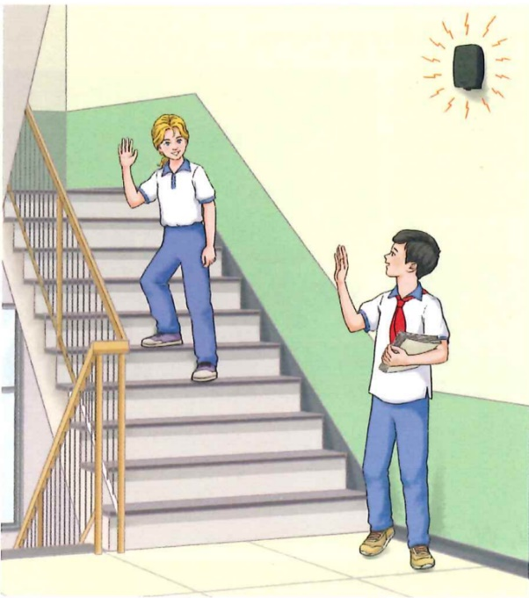
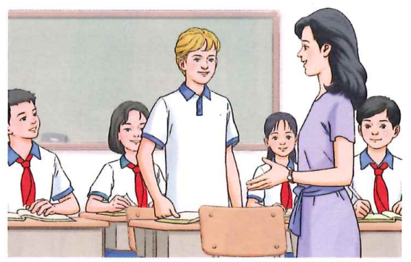
the scene pictures
at the school gate
at the break
at the break
A
in class
C
D
B
get to know
each other
get to know new friend
greet old friend
greet friends
What order can you put them in?

Slide 6
how to greet people and start a conversation?
How do you greet people?
How do you start a conversation?
meet for the first time
know each other
I’m…
Hello!
Hi!
My name’s…
Good morning!
How are you?
What’s your name?
/afternoon/evening!
May I have your name?
responses
what to talk about?
How do you spell your name?
E-M-M-A, Emma. M-I-L-L-E-R, Miller.
You can call me Emma.
how to end the conversation?
Nice to meet you!
That’s the bell.
Let’s go to class.
Nice to meet you too!
It’s time for class.
It’s time to go to class.
Goodbye!
Bye!

Slide 7
Homework
Must do:
1.仿照2b编写两段对话(改变时间和地点)。可适当增加内容。注意字母的书写与格式。
2.朗读2b中自己编的对话。注意语音与语调。
Try to do:
与你的家人、朋友或自己双角色扮演2b对话，并录制短视频。

Slide 8
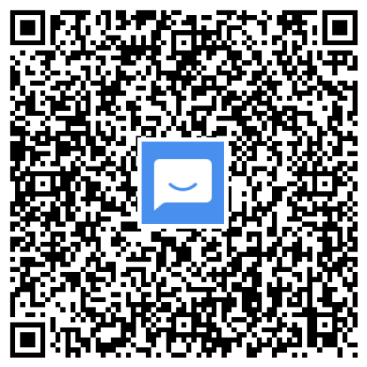
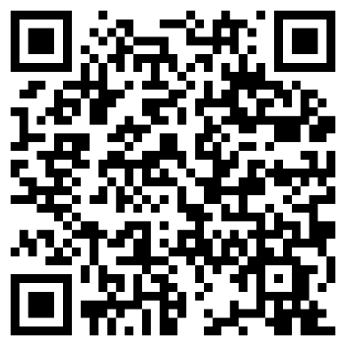
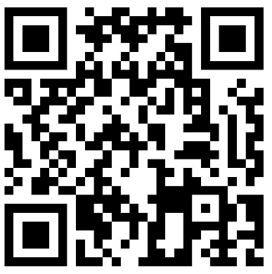
©本课件著作权属成都领航教材教法研究工作室.学程先锋所有，受《中华人民共和国著作权法》保护。除法律另有强制性规定外，未经成都领航教材教法研究工作室.学程先锋的特别书面许可,任何单位或个人不得以任何方式非法地使用本课件内容，不得私自转发给超越授权使用范围的第三方，不得将本课件用于任何商业用途。若需商用或取得课件的全部内容，请联系：028-87323348。
入群获取全套教学课件： | 扫码查看2024版电子样书： | 扫码领取2024版纸质样书：
联系电话：028-87323348

Slide 9
©本课件著作权属成都领航教材教法研究工作室.学程先锋所有，受《中华人民共和国著作权法》保护。除法律另有强制性规定外，未经成都领航教材教法研究工作室.学程先锋的特别书面许可,任何单位或个人不得以任何方式非法地使用本课件内容，不得私自转发给超越授权使用范围的第三方，不得将本课件用于任何商业用途。若需商用或取得课件的全部内容，请联系：028-87323348。
入群获取全套教学课件： | 扫码查看2024版电子样书： | 扫码领取2024版纸质样书：
联系电话：028-87323348

