Slide 1
《蓉城主阵地》2024-2025学年英语
七年级上册
Starter Unit 1

Slide 2
STARTER UNIT 1
SECTION A
1a-1b
导入课

Slide 3
How about starter unit 2 ?
P1-P3
P4-P6

Slide 4
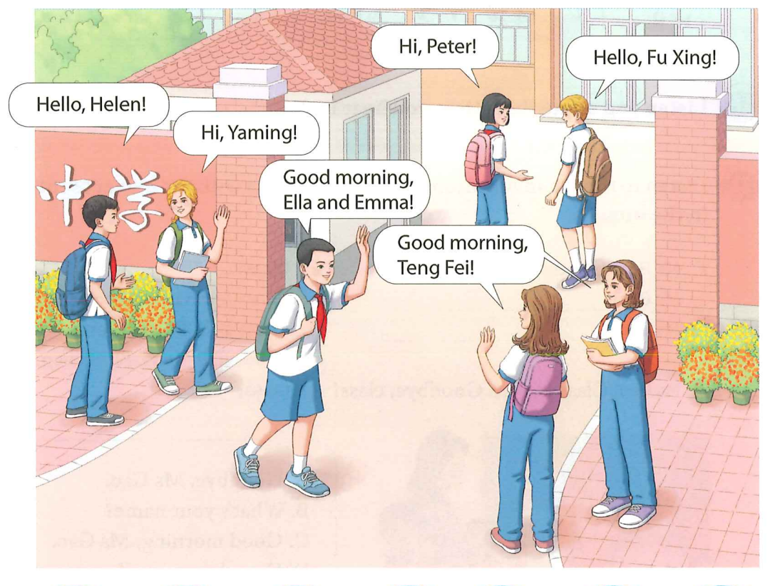
1. What can you see in the picture?
I can see 7 students, some flowers
and a middle school.
2. Where are the students?
They are at the school gate.
3. When is it?
It is in the morning.
4. Only 3 students are wearing red
scarves, why?
5. What do they say to each other?
Hi, Hello and good morning.
6. Why do they say so?
Greet each other.

Slide 5
What’s the response?
Who are they greeting?

Slide 6
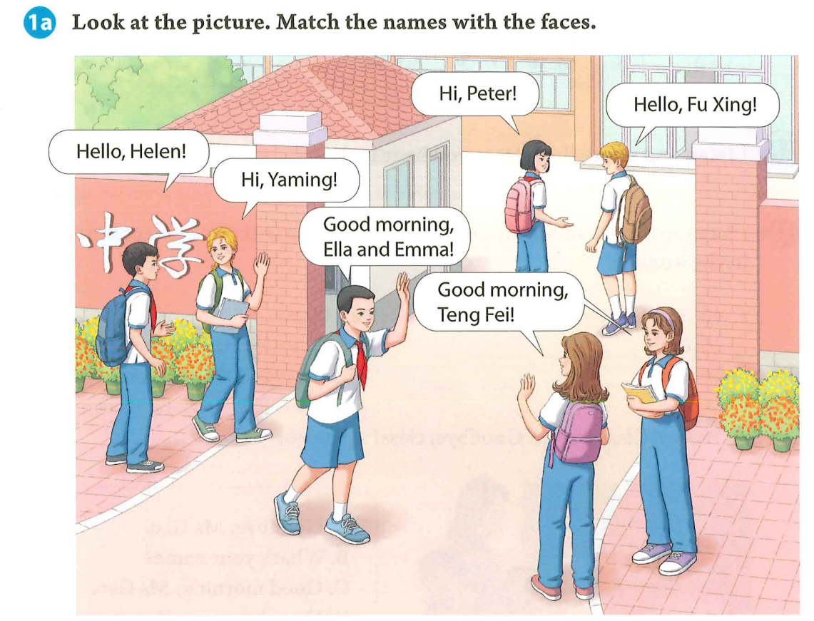
/eɪ /
Please circle all the names in the picture.
You can say I circle…
I match Ella with Ella’s face.
I match Emma with Emma’s face.
Ella and Emma are twins.
Ella has longer hair.
Emma wears a hair band.

Slide 7
看图，请把名字与人脸相匹配。
/iː/
Fu Xing
Peter
/e/
/e/
Teng Fei
Yaming
Helen

Slide 8
Game: I point , you say
Teng Fei
Fu Xing
Yaming
Peter
Helen
Why should we remember their names?
We can greet people better.

Slide 9
Why do they greet each other with names?
They know each other.

Slide 10
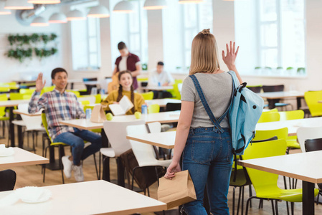
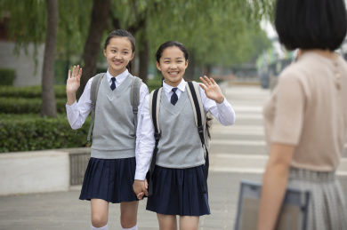
How do they greet each other?
Have a conversation with your partner.

Slide 11
Homework
Must do:
1. 尝试运用不同打招呼的语言，主动招呼你认识的人，并把你们的对话写下来。
2.记忆1a中人物形象及其名字。
Try to do:
1.对照单词表，根据音标读P1的八个单词。
2.给自己找一个英语名字，并查找这个名字的意义。（字典、网络……）

Slide 12
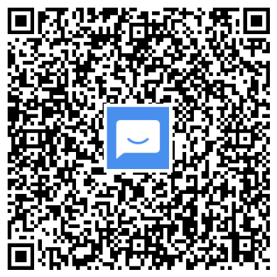
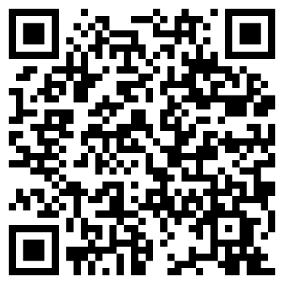
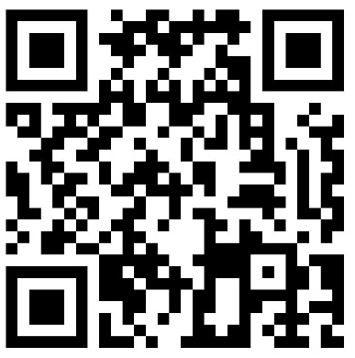
©本课件著作权属成都领航教材教法研究工作室.学程先锋所有，受《中华人民共和国著作权法》保护。除法律另有强制性规定外，未经成都领航教材教法研究工作室.学程先锋的特别书面许可,任何单位或个人不得以任何方式非法地使用本课件内容，不得私自转发给超越授权使用范围的第三方，不得将本课件用于任何商业用途。若需商用或取得课件的全部内容，请联系：028-87323348。
入群获取全套教学课件： | 扫码查看2024版电子样书： | 扫码领取2024版纸质样书：
联系电话：028-87323348

